Slide 1
Visual Analytics - Final Project
Visualizing USA road accidents
Alessio Fiorenza, Federica Di Marco

Slide 2

A year of road accidents in the USA
Every year, more than 6 million road accidents happen in the USA.
Main focus of this work:
show how the number of road accidents per state change month to month.
display patterns in severity and its relationship with weather conditions.

Slide 3
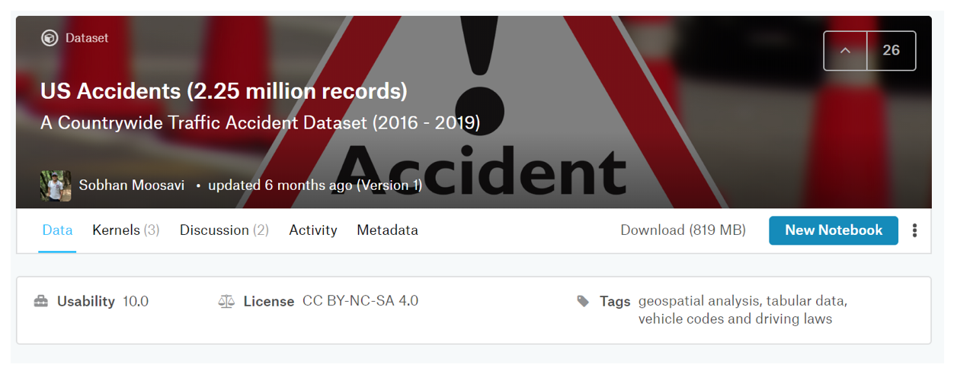
The Dataset
We got our data from the www.kaggle.com website, and represents the set of road accidents from February 2016 to March 2019.

Slide 4
Preprocessing on data
The dataset contains about 2.25 million record, each one of those with 49 attributes.
We couldn’t just load via js, so we did some pre-processing.
Grouped accidents by severity and considered just the 2018 year
Queried the data and grouped by month, state, day and night
Sampled about a thousand records in order to visualize single instances on the PCA plot and the Parallel Coordinates.

Slide 5
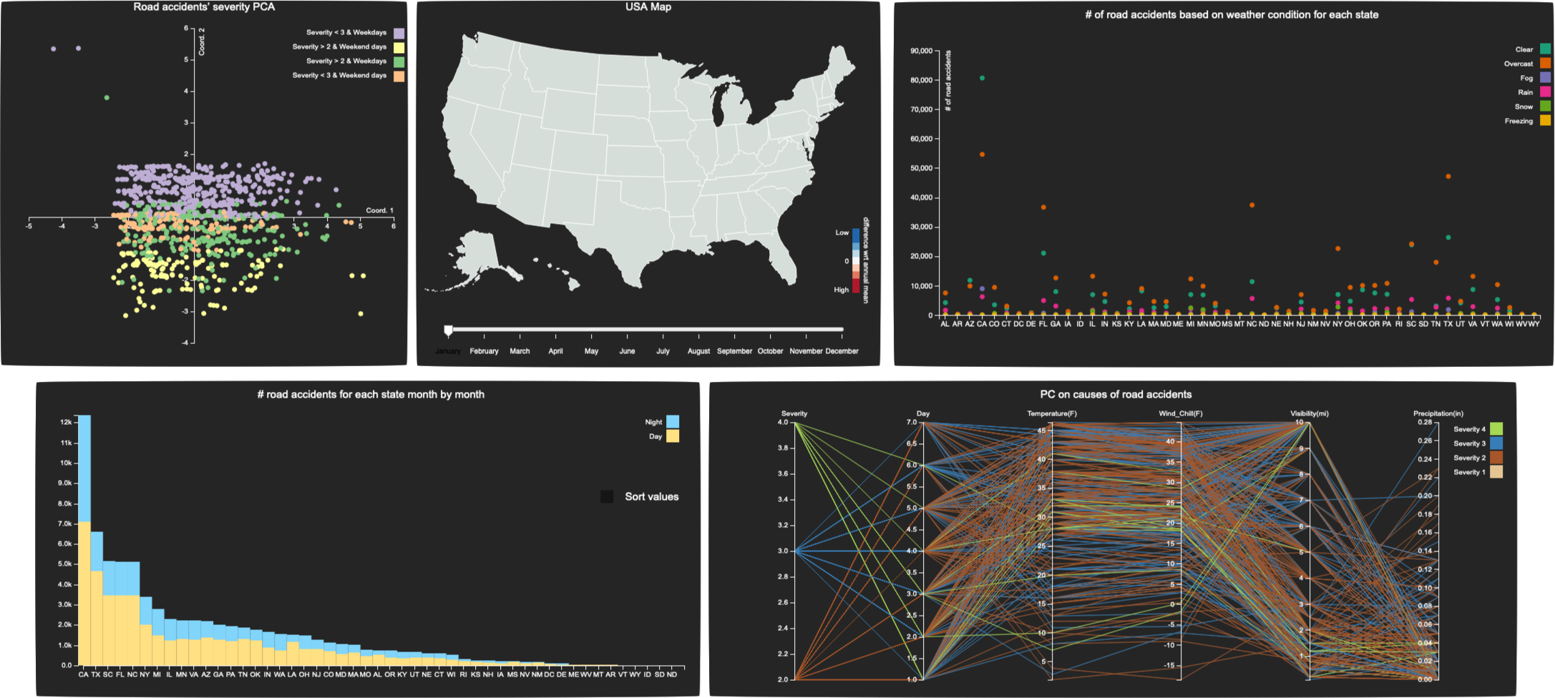
Visual Environment
This work consists of five views, grouped in two semantic groups:
States patterns across time
Road accidents severity and correlation to weather conditions

Slide 6
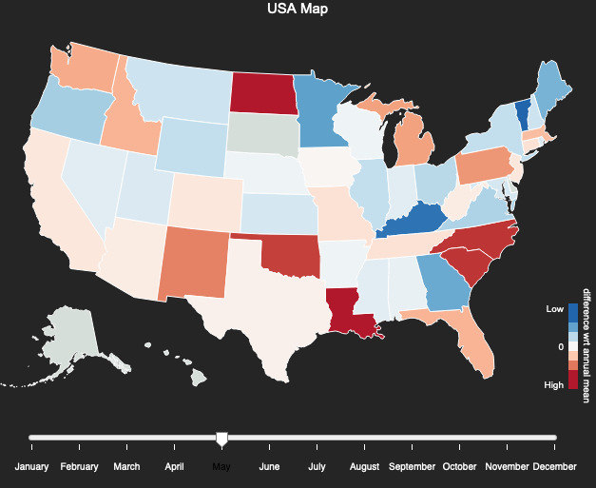
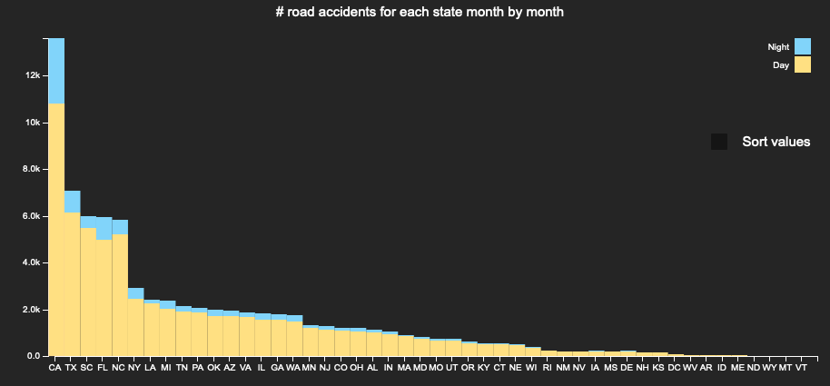
State patterns
The first group of views, has the goal to visualize for each state, month by month, the amount of road accidents.
This is done both qualitatively (through an heatmap), and quantitatively (via a stacked bar chart, separating day by night).

Slide 7
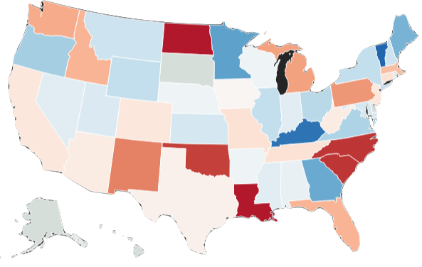

Qualitative analysis
less or equal to -2*stdDev
Montana in May there are not a lots of road accidents
low
Each state is colored according to a state-dependent heat map.
It represents the difference between the number of road accidents in that month, and the mean value for the whole year.
mean
high
Means greater or equal to 2*stdDev
Slider to switch between months
Louisiana is having a lot of road accidents wrt its annual mean

Slide 8
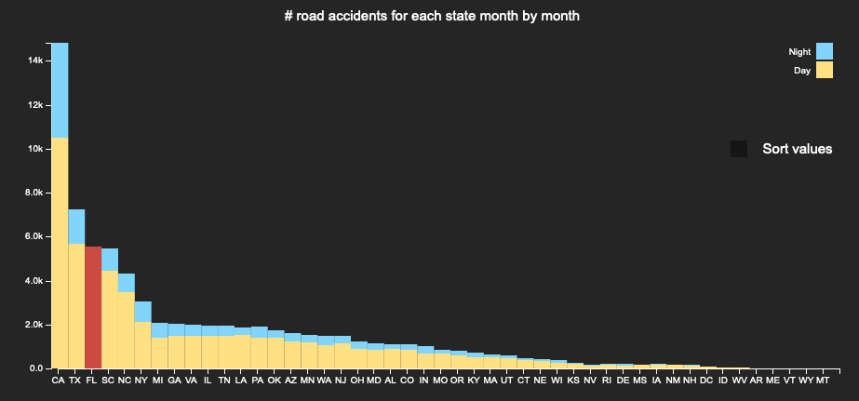
Quantitative analysis
An histogram is used to plot the exact number of car accidents in a particular month (dependent by the slider) dividing day and night for each state.
On mouseover, on a particular state on the heatmap, the bar is highlighted.
If a bar is hovered, a label shows the exact number of day/night accidents

Slide 9
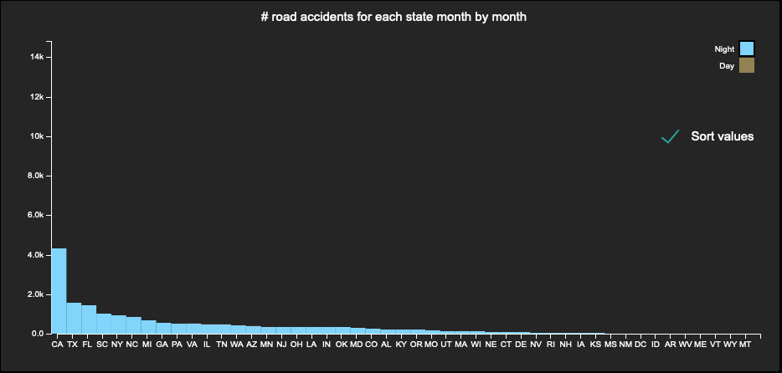
Quantitative analysis
It is possible to select on the legend “Day” or “Night” to show just those road accidents:
On click, the bars will be sorted in a decreasing way with respect to the number of accidents.

Slide 10
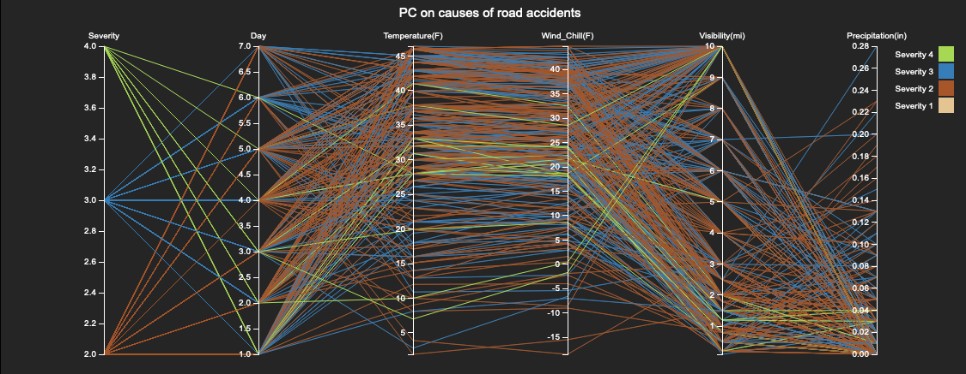
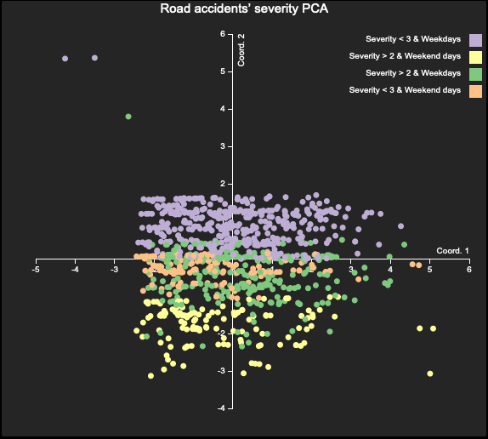
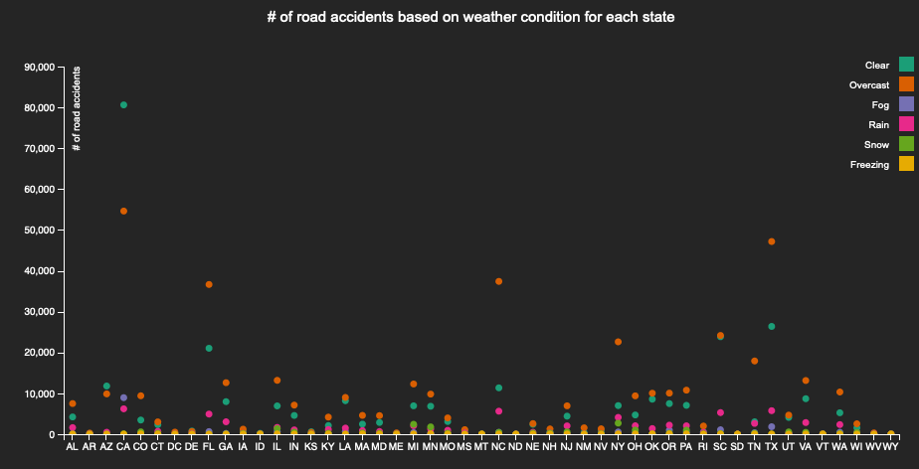
Severity – Weather conditions correlation
In this group, two different views (PC and PCA) support the analysis of the car accidents and of its correlation to weather conditions and days of the week throughout the whole year. Moreover there is another view (SC) that represent the total amount of accidents during that year on different weather conditions.

Slide 11
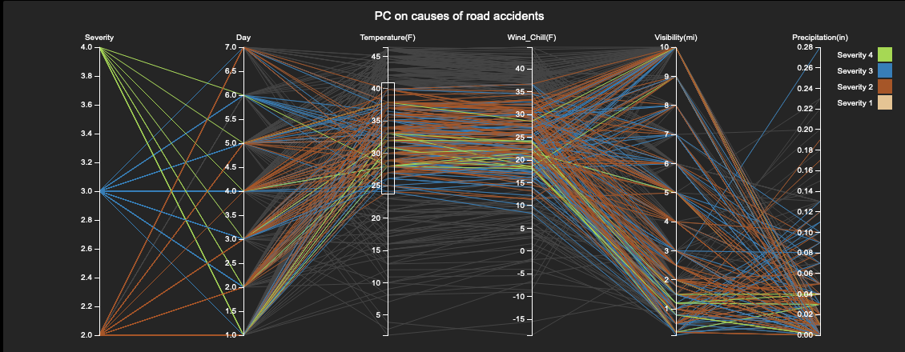
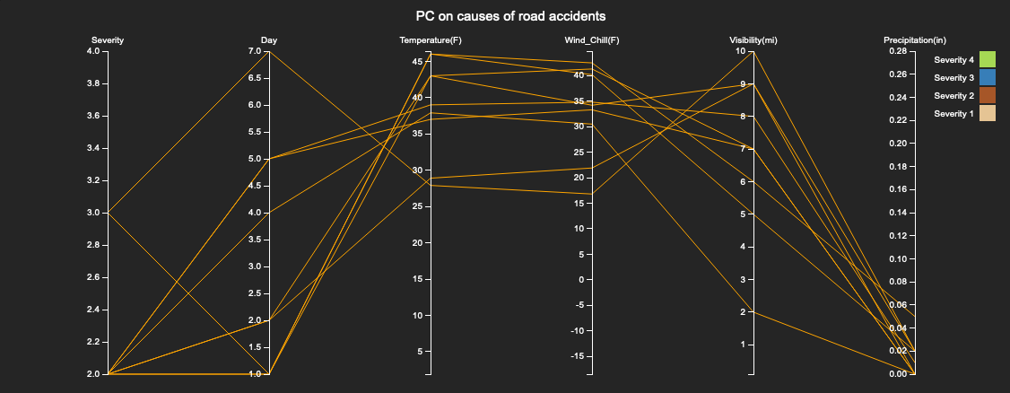
Parallel Coordinates
Another view coordinated with the U.S. map, is the parallel coordinates one.
It displays accidents’ severity, with day of accident, temperature, wind chill, visibility and precipitation.
It is possible to select a severity and only the accidents with that severity will be shown.
When a state gets selected on the map road accidents of that state get colored in orange.

Slide 12
PCA Scatter Plot
Accidents data are fed to a PCA algorithm and the first two components are displayed in a scatter plot.
Points are colored according to their class:
Weekdays accidents with severity < 3
Weekdays accidents with severity > 2
Weekends accidents with severity < 3
Weekends accidents with severity > 2
It is interesting to see that accidents tend to form clusters in the projection thus probably also in higher dimensions.

Slide 13
Scatter Plot
Accidents are grouped by the different weather conditions.
The total amount of accidents are colored through different colors based on weather conditions.
Accidents tend to be greater with clear and overcast weather condition. This is justified since during a year this conditions are the most common.
Groups can be zoomed

Slide 14
Discarded Views
During the development, we dropped several designs
Time-series chart
Not enough insights
Radar chart to show the causes of the accidents in one state
Just a focus on one state at time, lack of a general overview of all states

Slide 15
DEMO

Slide 16
Thanks, questions are welcome

